Slide 1
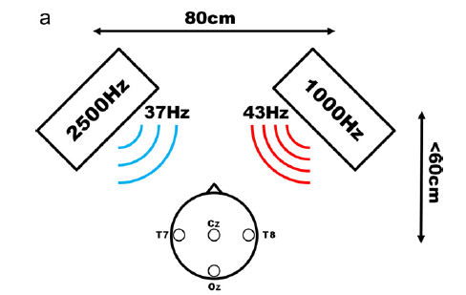
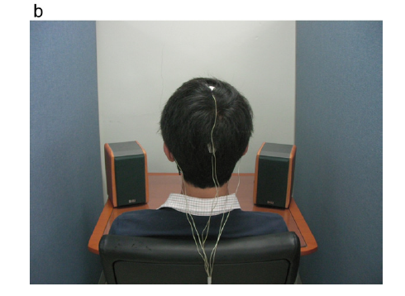

Slide 2
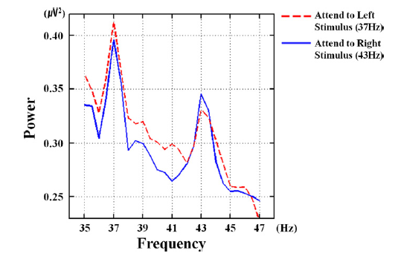

Slide 3
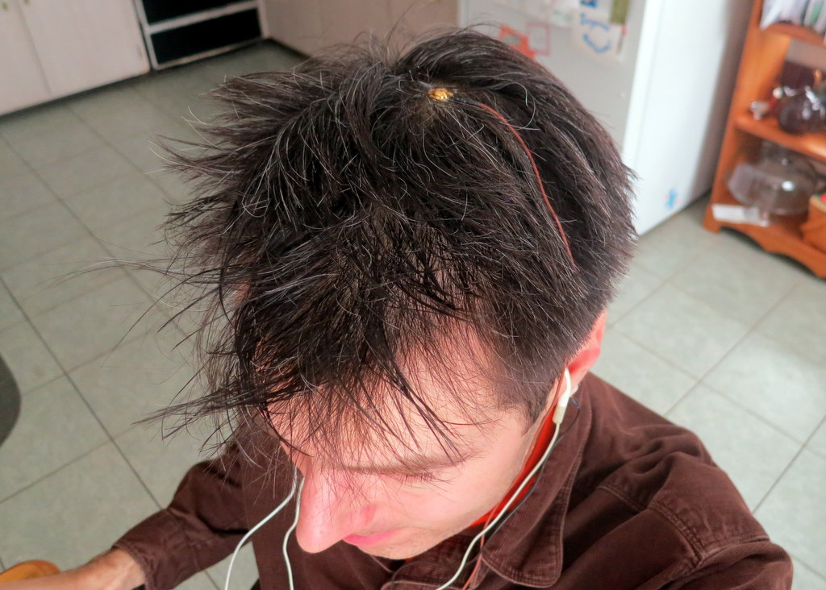
EEG Chan 1 (Cz)
EEG Bias (Ear Lobe)
Ear Bud
(AM Tones)
EEG Ref (Ear Lobe)
Ear Bud
(AM Tones)

Slide 4
